Slide 1
Capstone Project: Online Registry for Chicago Lower Extremity Surgical Foundation (CLESF)
Christine Clark
Paul Kadota

Slide 2
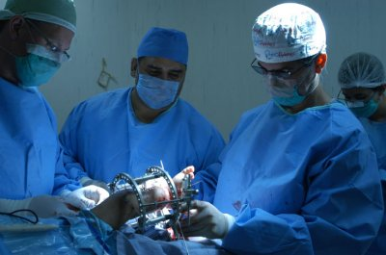
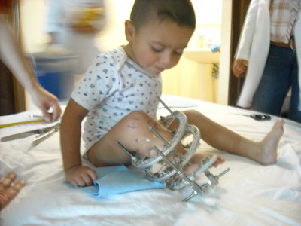
Product Piece 1 – Do not delete this text box - used for hyperlinks
Background
The Chicago Lower Extremity Surgical Foundation aims to be a leader in post-academic education and outreach and provide treatment for pediatric and adult lower extremity deformities in communities where it is most needed.
CLESF has a network of dedicated doctors and medical professionals in the U.S. and Mexico that join with a common bond of helping patients via CLESF’s medical mission, primarily in Latin America.
Doctors volunteer their time, pay for their own travel, expenses, equipment etc
In the last 10 years, CLESF has performed 130 operations.

Slide 3
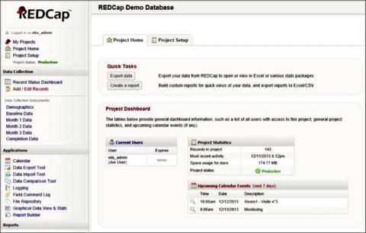

Product Piece 1 – Do not delete this text box - used for hyperlinks
Scope of Capstone Project
Problem Statement
To date, CLESF has been using very basic methods to document patients from the medical mission. Once CLESF’s U.S. team departs Latin America, follow up and tracking of the patients becomes more challenging, as Latin American doctors return to their full-time employment. CLESF needs an efficient way to document and track patients for both U.S. and L.A. doctors who work on the cases.
Objectives
1.) Develop an online registry system to track non-profit organization’s medical mission patient profiles and outcomes.
2.) Registry should be integrated and web-based to effectively document medical mission cases including patient profile, conditions, pre-/intra/post-operative condition and procedures, as well as patient follow up.
3.) System must provide at a minimum a baseline level of analytical capability to assess tendencies in treatment and patient outcomes.

Slide 4
Product Piece 1 – Do not delete this text box - used for hyperlinks
Methodology
Create a REDCap Database
REDCap is a secure web application for building and managing online surveys and databases. While REDCap can be used to collect virtually any type of data (including 21 CFR Part 11, FISMA, and HIPAA-compliant environments), it is specifically geared to support online or offline data capture for research studies and operations.
Host the database at the University of Chicago Center for Research Informatics (CRI)
The University of Chicago Center for Research Informatics will create a partnership with CLESF to host their clinical database.
Apply for IRB approval for storing patient information.
Capstone team and CLESF will create an IRB/consent form for data collection for future surgical procedures.
An additional IRB will be required to store past medical records.

Slide 5



Winter Quarter 2017 Timeline
Project Proposal
Information Gathering
Discussion with Advisors
Capstone team select CLESF online registry project. Team explores options for recording patient data
Capstone team discusses options for web hosting , online clinical databases and IRB’s
First Meeting with CLESF
Second Meeting with CLESF
CLESF personnel detail the scope of project. Capstone team offers possible solutions..
Capstone team recommends REDCap database for CLESF. CLESF inquires about financial costs and long-term support.

Slide 6
Spring Quarter 2017 Timeline
Project Implementation
Design Patient Data Template
Test Web-based & mobile REDCap implementation
Using parameter provided by CLESF, Capstone team designs a template for clinical data
Field test clinical database in US and Mexico.
REDCap Training
Past Patient Data Entry
UC CRI offers online and in-person training for the use of REDCap.
There are 130 case files from past surgeries that need to be included in the patient database.

Slide 7
Summer Quarter 2017 Timeline
Project Writing and Presentation
Project Review with Advisors
Capstone Project Presentations
Capstone team meets with advisors for analysis and direction for project writing results.
Capstone team present project to peers and advisors.
Project Review with CLESF
Write Formal Paper
Capstone Team meets with CLESF for feedback and review of REDCap implementation.
Capstone team prepares a written synopsis of project

Slide 8
The Meeting
Key Stakeholders
Project Manager CLESF
Sarah Inciong
UC Advisors/Faculty
Sam Volchenboum, Suzanne Cox, Imran Khan, Julie Johnson
Types of patient Information
MScBI Student
Paul Kadota
Online Patient Registry for CLESF
Prevalence of REDCap Databases
Required Information
MScBI Student
Christine Clark
President, Co-Founder CLESF
Ramiro J. Atristain-Carrion
*Blue arrowheads are buttons!

Slide 9
*Puzzle pieces and blue arrowheads are buttons!
Capstone Project Development
CLESF REDCap Patient Database Pipeline
Functionality of REDCap Database
1.) IRB Approval
1.) Data Integration & Analysis
2.) Web-Hosting Service
3.) REDCap
Design

Slide 10
Capstone Project Pipeline
Project Pieces:
IRB Approval
Web-hosting Service
REDCap Design
Data integration & Analysis

Slide 11
Project Creation
Project Pieces:
IRB Approval
Web-hosting Service
REDCap Design
Data integration & Analysis
Capstone Project Implementation
Online Patient Registry for CLESF

Slide 12

Online Patient Registry for CLESF
Development and implementation of an online registry system to track Chicago Lower Extremity Surgical Foundation’s medical patient profiles and outcomes.

Slide 13
Product Piece 1 – Do not delete this text box - used for hyperlinks
Challenges
IRB Approval
University of Chicago IRB – since data is collected outside of U.S., normal requirements do not apply
Provided CLESF with independent IRB referral, http://eandireview.com/
Historical Data
CLESF to manually enter information from 130 surgeries
Online Consent Form/Waiver
Created form within REDCap with Signature field
CLESF to review content of form with independent IRB before database moves to production to ensure use of historical and future data is covered for operational improvement and potential research
Hosting Options - CRI
Costs?
HIPAA/Security concerns?
Data entry/access/maintenance? Requires CRI access/approval for CLESF Project Admin at minimum
CLESF IP guarantee
Data Types: Xrays/images – size and maintenance/storage?
Provided CLESF with suggestions for external hosting options – is portability an obstacle? CLESF wants to use REDCap

Slide 14
Product Piece 1 – Do not delete this text box - used for hyperlinks
Advantages of REDCap
Low Overhead Costs
Two main components: Personnel & Hardware
Personnel: One dedicated REDCap Administrator, some clinical and IT support (0-60K)
Hardware: File and back-up serivers (~10K)
Diverse Functionality & Ease of Use
Connects multiple types of professionals – researchers, clinicians, statisticians, IT, Project Manageers (See Figure 1)
Requires only basic understanding of biomedical informatics to use and moderate BMI to design a patient registry

Slide 15
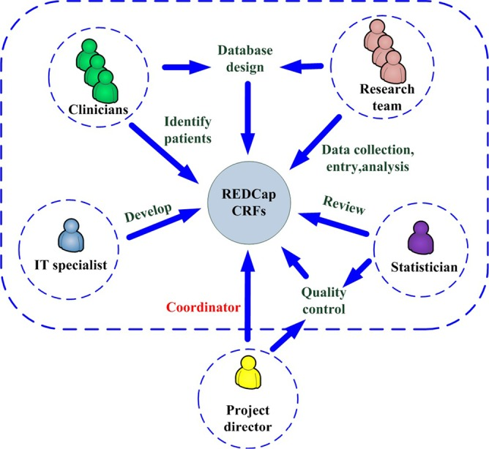
Figure 1 – REDCap Project Management
[This figure was taken from “Construction and Management of ARDS/sepsis Registry with REDCap” in the Journal of Thoracic Disease] [I am not sure if I can cite this paper and copy the figure or if it would be best to recreate the workflow. This diagram shows how multiple professionals can easily collaborate on a project using the REDCap application as a common ground.]

Slide 16
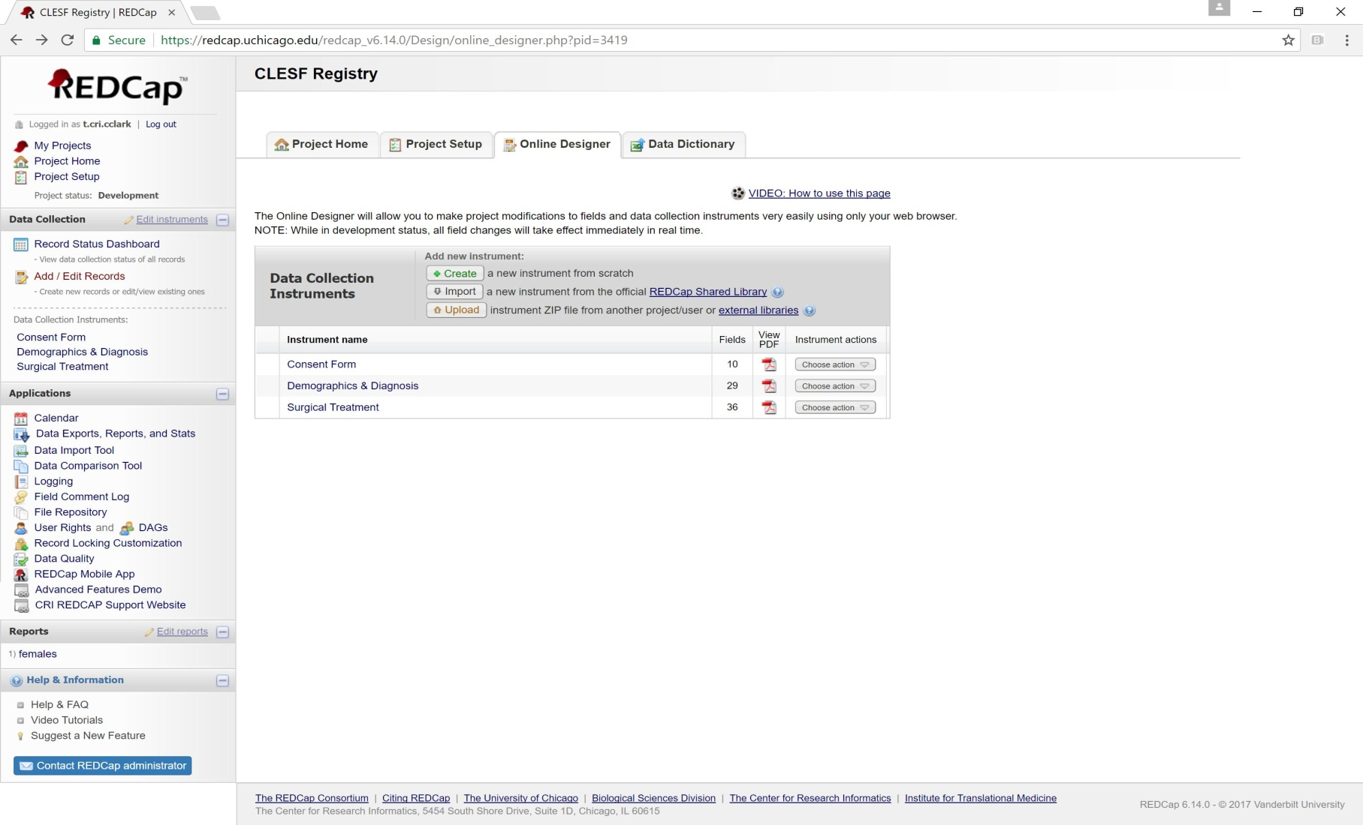
Figure 2 – REDCap CLESF Registry
The CLESF Registry is a bilingual (English/Spanish) online database to manage patient information. This screenshot was captured on the web-based REDCap portal. This is the home page of the registry and it shows the three instruments contained in the registry: Consent Form, Demographics & Diagnosis, and Surgical Treatment.

Slide 17
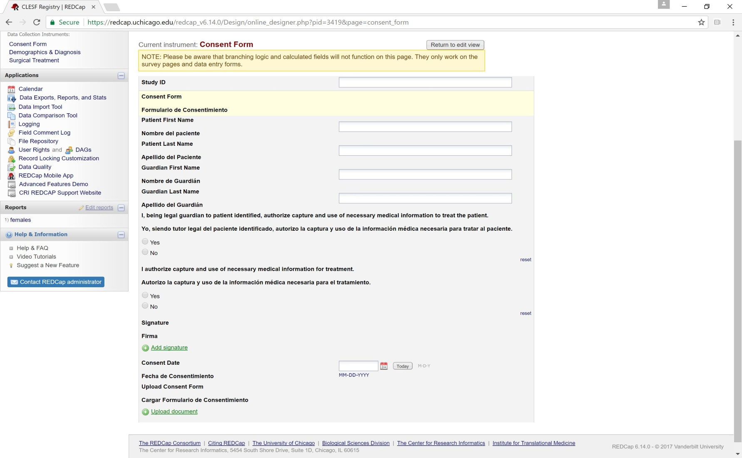
Figure 3 – Digital Consent Form
The patient consent form is the first data collection instrument in the CLESF Registry. The form allows a digital signature and an area to upload a paper consent.

Slide 18
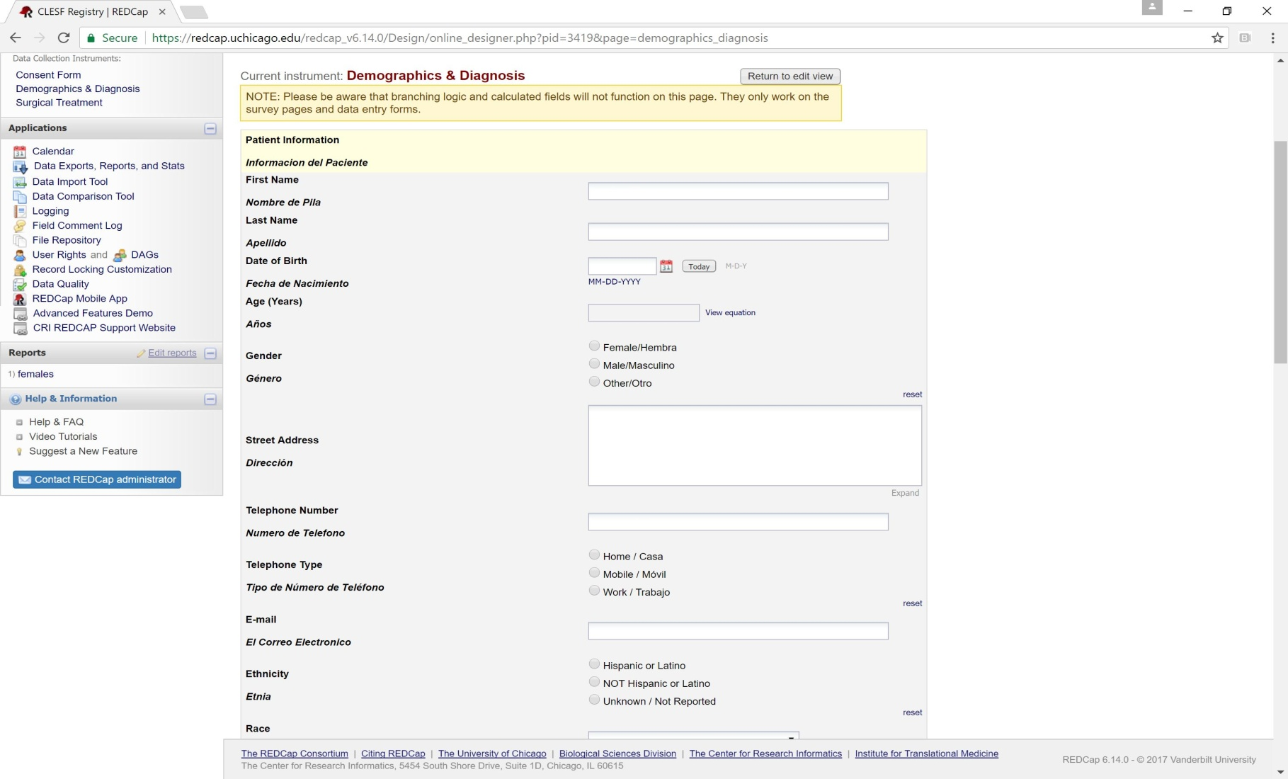
Figure 4 – Demographics & Diagnosis
This form contains fields for the demographic and general medical information. There are several conditional fields that only reveal if needed. These conditional fields follow branching logic embedded into the registry.

Slide 19
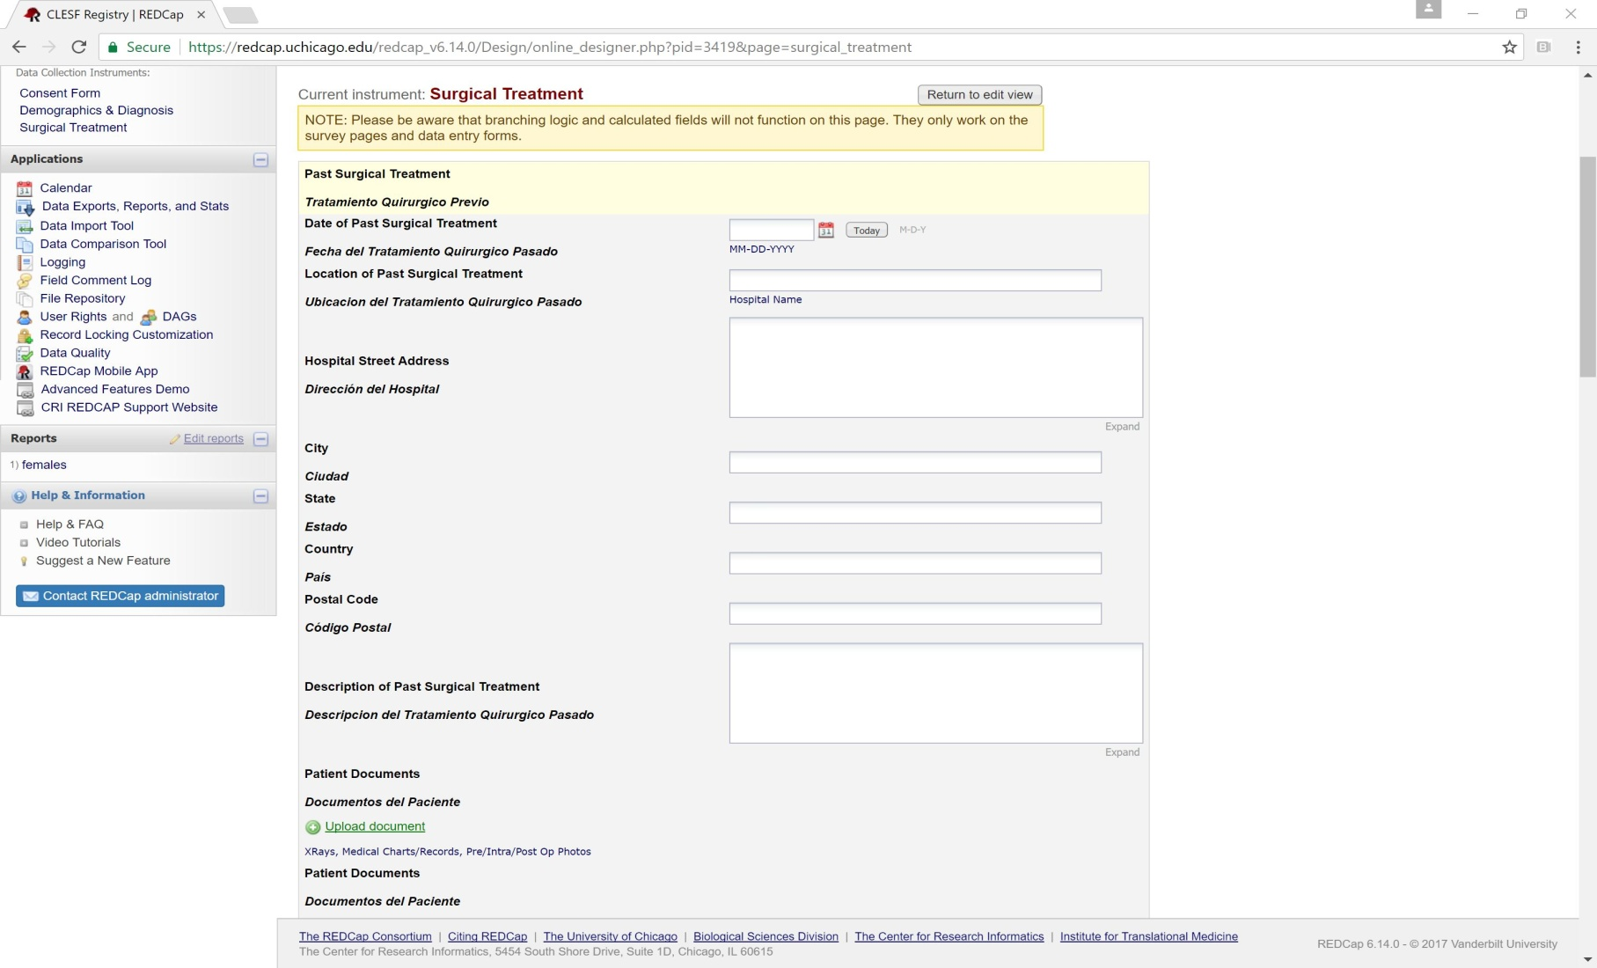
Figure 5 – Surgical Treatment
This form contains fields for information about the surgical treatment. There are several places to upload medical images, such as x-rays. This instrument also contains branching logic that reveals additional fields if necessary.

Slide 20
Product Piece 1 – Do not delete this text box - used for hyperlinks
Limitations & Areas for Improvement
Heavy Use of Free Text
As requested, the registry includes several free text response fields
Without native Natural Language Processing (NLP), it will be difficult converting medical narratives into meaningful information.
Create hierarchical data fields to codify medical narratives
Lack of Longitudinal Data
Each patient ID is not only an identifier of the patient but also a single point in time.
Create additional instruments to capture the continuum of care for a single patient
Manual data entry required
Lack of automatic data population from medical instruments
Large of backlog of past surgical procedures need to be manually entered
Take advantage of REDCap to Excel conversion functionality
With a moderate understanding of REDCap data exporting, one can format past surgeries into REDCap forms using Excel spreadsheets.

Slide 21
Workbook / Tablet Close up Page – Do not delete this text box – used for hyperlinks
REDCap Template
CLESF Surgeries
REDCap Template
Current Users
By creating on online and collaborative registry, doctors from various countries can provide input and feedback to the medical mission patients.
This will not only ensure the best outcomes for the patients, but also enable CLESF to effectively review trends in conditions, procedures and outcomes.
Patient Information
Data Import/Export
Calendar
Project Statists

Slide 22
Meeting Notes #1 – do not delete this text box - used for hyperlinks
Types of Patient Information
Types of Information
Patient Information
1.) PHI, history
2.)Interviews with families
Background
Recurring info across cases, metadata
Additional information
1.) Images, xrays
2.) Allow for dialogue between doctors; currently using WhatsApp
3.) Commentary from doctors
4.) Surgical follow-up
Back Button

Slide 23
Meeting Notes #2 – Do not delete this text box - used for hyperlinks
Identify Needs of CLESF
Requirements
1.) Protected Health Information
2.) Storage/Security
3.) Data Governance
4.) Data Capture
5.) Search Function
6.) Reporting/Analysis
7.) Administrative Tool
Back Button

Slide 24
Meeting Notes #3 – Do not delete this text box - used for hyperlinks
REDCap Statistics
Prevalance of REDCap
2264 Institutions Use REDCap
REDCap is available in 108 countries
There are ~ 372,000 REDCap projects with 476,000 users
To date there are 3,170 scholarly articles that cite REDCap
Back Button

Slide 25
Product Piece 1 – Do not delete this text box - used for hyperlinks
Project Pipeline: IRB Approval
With such a small practice, the logical step for CLESF would be to create a consent form for medical treatment that includes future use of data for research and/or treatment, payment, operations, and quality improvement.
The old data is likely approved for quality control but not research, so you would need a different IRB to approve the use of already collected data for collection in a registry.
In essence, the new consent form would allow for the data to be stored in the registry, and the IRB protocol would allow for the retrospective data to be stored in the registry. Each new research question would need IRB approval to use the registry.
- Credit Julie Johnson (IRB Advisor)

Slide 26
Product Piece 2 – Do not delete this text box - used for hyperlinks
Project Pipeline: Web-hosting Service CRI
REDCap database hosted by CRI, identify data ownership, management, and governance. We need to be clear on CLESF’s IP rights at CRI.
Many legal aspects of this project are still being discovered. Until we have a better understanding of the consents/waivers, it is hard to make a thorough assessment of using University of Chicago Center for Research Informatics as web-host.

Slide 27
Product Piece 3 – Do not delete this text box - used for hyperlinks
Project Pipeline: REDCap Template Design
1.) Historical Information
2.) Patient Information
3.) Images/X-Rays
4.) Costs associated with surgeries
5.) Socio-economic information
6.) Login Security
7.) Forms in both English and Spanish
8.) Web-portal & Smart phone app

Slide 28
Product Piece 4 – Do not delete this text box - used for hyperlinks
Project Pipeline: Data Integration/Analysis
- There have been130 patients in last 10 years, primarily within Latin America
- Data collected on paper or via PDF by doctors and sent to CLESF
CLESF created form but not frequently used Require upload/input of historical data for reference & search
- REDCap exports data to excel. We may have the opportunity to run linear regression to model explanatory variables.

